Slide 1
Proposal for Enhancement slides
By Jihong Zhang and Hejin Wang

Slide 2
Group members
Our Leader: Jinlun Zhang (16jz61@queensu.ca)
2 Presenters: Xueyi Jia (18xj8@queensu.ca)
Jihong Zhang (19jz138@queensu.ca)
Other group members:
Yunhan Zhou(17yz101@queensu.ca)
Hejin Wang(15hw45@queensu.ca)
Jing Tao(21jt35@queensu.ca)

Slide 3


Contents
Introduction
SAAM Analysis
Concurrency
Use Case
Pros and Cons
Conclusion

Slide 4


Introduction
The Proposal for Enhancement for Bitcoin Core System we call it “Miner Rental Functionality”

Slide 5
Individual Mining to Rental Mining
Since "Miner" component within Bitcoin Core is in charge of generating candidate blocks and appending them to the blockchain, and the "Miner" can be located on a different machine and accessed by the user remotely
Based on this, users can be provided another way to get miners by “Miner Rental Functionality”, this means experienced miners can borrow multiple miners to accumulate wealth, and those who have idle miners can choose to rent out their own mining machines in exchange for bitcoin

Slide 6
SAAM Analysis
For implementation 1, the first implementation of “Miner Rental Functionality” is enabling users to rent out or rent in miners by relying on the existing Bitcoin Core P2P network and the enhanced Client-and-Server architecture style of the Bitcoin Core instance, it is realizable to allow other users on the Bitcoin Core P2P network to remotely control someone’s miner through their own RPC-API component and Connection Manager component, provided that the someone authorizes the miner to be publicly accessible (renting out the miner).

Slide 7
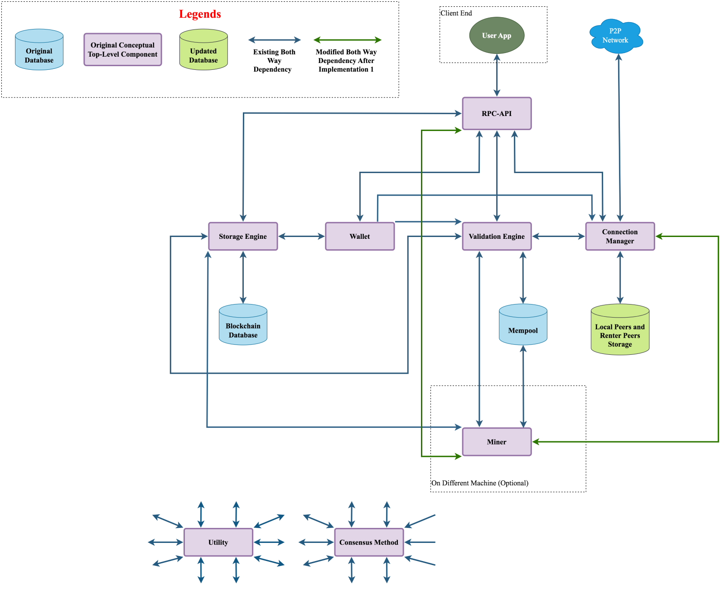
Implementation 1
As shown on Figure1 (Conceptual Architecture), according to the design of implementation 1, any user with a functional miner should be able to initiate a broadcast of “starting or terminating renting out the miner” to the P2P network, and this broadcast should be received by all the nodes on the P2P network iteratively just like how a normal transaction broadcast is propagated and received on the network.
Figure 1: Bitcoin Core Updated Conceptual Architecture after Implementation 1

Slide 8
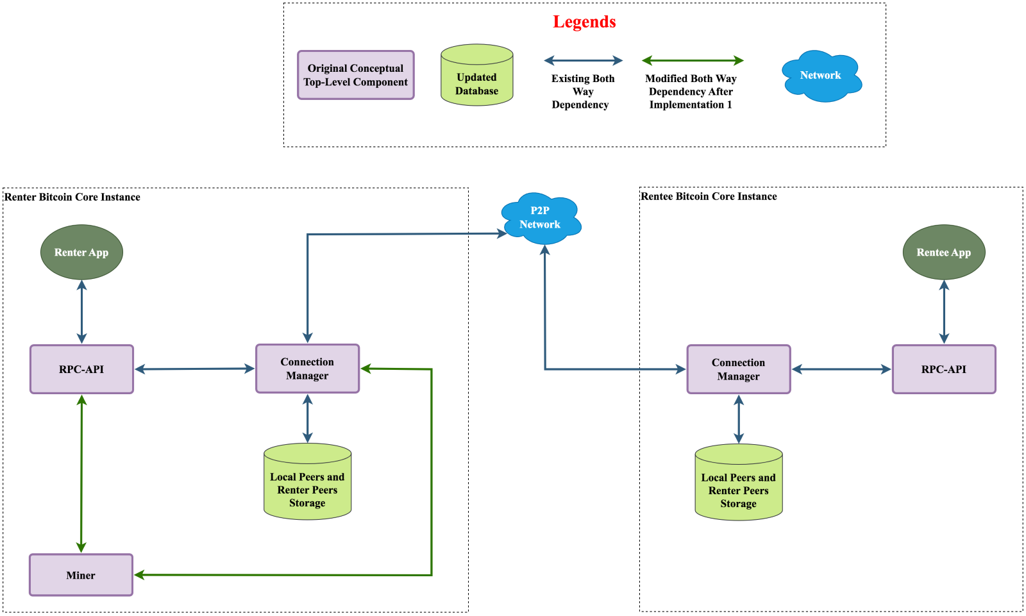
Once the rental transaction is received and validated by the renter, a direct connection between the renter’s miner and the RPC-API component of the rentee is established ad hoc through the Connection Manager components of both parties as shown on this Figure.
Regarding the effects of the enhancement under implementation 1 on Bitcoin Core, the evolvability of the software should be significantly improved, because many additional features or enhancements can be researched and implemented for the “Miner Rental Functionality”.
Figure 2: Simplified Conceptual Illustration of Implementation 1 of Miner Rental Functionality

Slide 9
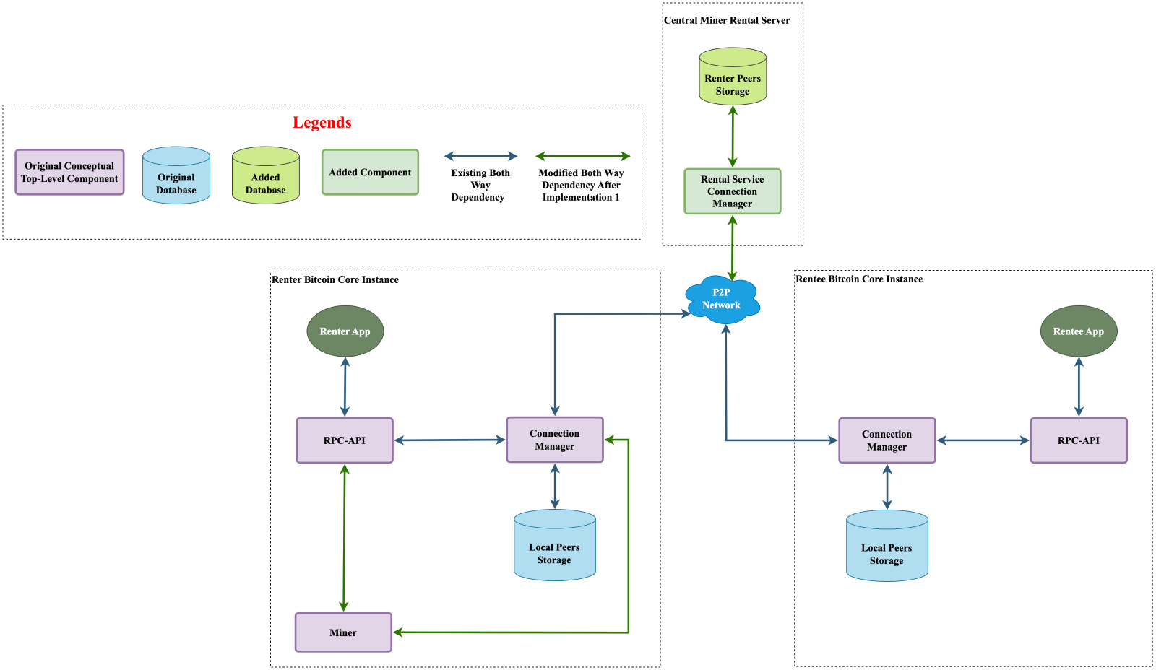
Figure3: Simplified Conceptual Illustration of Implementation 2 of Miner Rental Functionality
As shown in Figure 3. Under such implementation, each peer in the network is not required to utilize its own storage space and computing resources to maintain a copy of the “renter peers” list.
The second implementation of the "Miner Rental Functionality" involves a new server called the "Central Miner Rental Server" or CMRS, which manages users to rent in or rent out miners. All the users on the Bitcoin Core P2P network can access the services of CMRS after being authenticated.

Slide 10
Implementations Comparison Regarding NFR
NFR | Performance | Scalability | Testability | Security | Availability | Maintainability | Integration
Implementation 1 | Medium Performance | High Scalability | High testability | High security | High Availability | High Maintainability | High integration
Implementation 2 | High Performance | Medium Scalability | High testability | Medium security | Medium Availability | High Maintainability | Medium integration

Slide 11
Concurrency
The Miner Rental Functionality triggers major concurrency enhancements to top-level components:
RPC-API
Connection Manager
Local Peer Storage
For implementation 1:
the upgraded “Local Peers Storage” component must be able to concurrently maintain both “local peers” list and the “renter peers” list if there are simultaneous updates to both of them.
For implementation 2:
the CMRS must be able to handle concurrent miner rental announcements and requests without conflicts, and the Connection Manager must be able to send and receive transactions to and from the network while maintaining stable and secure connections with the CMRS.

Slide 12
Stakeholder Analysis
This section will analyze our two new implementations from the perspective of the following three stakeholder roles: Users, Developers, and Investors:
Users: It allows users with functional miners to monetize their resources by renting them out. Users needing mining power can rent miners for a specific period, which could lead to a more efficient distribution of mining resources and increased revenue for users with idle mining capacity.
Developers: Since "The Miner Rental Functionality" (in implementation 1) is built upon the existing Bitcoin Core architecture, the number of modifications to the existing architecture is minimized, this also minimizes the impact on developers.
Investors: they could see potential growth in the Bitcoin ecosystem due to "the Miner Rental Functionality" because more users are able to access mining resources, the overall network security and mining competition could increase, contributing to the stability and growth of the ecosystem, consequently dragging more investors into the Bitcoin field.

Slide 13
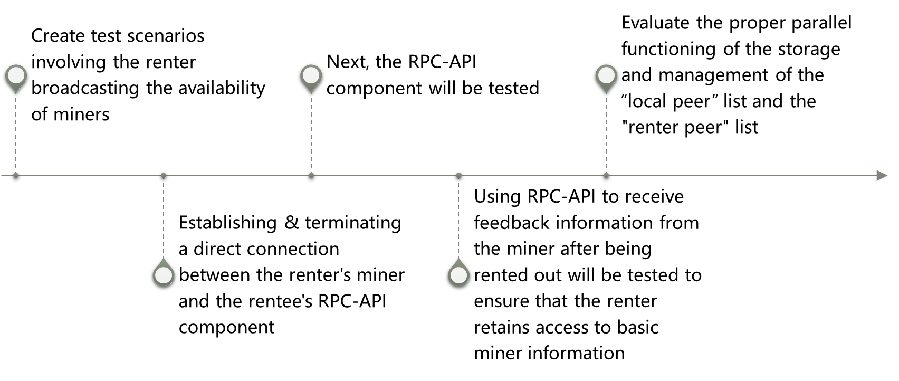
Testing Process

Slide 14
Use Case
Sequence Diagram of renting in a miner under Implementation 1

Slide 15
Pros and Cons
Pros
Cons
Beneficial for the users from the risk management perspective
As for the renters, this enhancement realizes a lower bound on the returns of their miners
"Miner Rental Functionality” will lead to the development of new and more powerful mining equipment, which can inspirate clients to cooperation and mining
Avoid Bitcoin Core users to resort to third-party services and platforms that provide mining rental services, which not only saves the brokerage fees for the users, but also eliminates the intrinsic risks involved in the unregulated mining rental services
There can be security vulnerabilities that could be exploited by malicious actors
Legal and regulatory risk
The centralization of mining rights
Since the "Miner Rental Functionality" relies on the voluntary participation of users in renting out their miners, it can lead to fluctuations in the number of miners available for rent at a given time, which is a limitation that may affect the rental market

Slide 16
Lesson Learnt & Conclusion
We studied and designed an implementation of the enhancement based on the proposed architecture of Bitcoin Core itself
Through brainstorming, we came up with another implementation with a dedicated server that goes against the Bitcoin Core decentralized nature
After in-depth studies and discussions of how to realize the implementations in practice, we articulated more details to be dealt with.
The proposed enhancement's analysis and benefits have been performed
Functional requirements, non-functional requirements, and stakeholders were taken into consideration during the enhancement's SAAM analysis.
Efficiency and requirements were analyzed separately in detail under comparison.
Two use cases and sequence diagrams were brought up to further evaluate the execution of the enhancement.
Potential risks and major limitations were considered.

Slide 17
Thank you

